Slide 1






How to help you and your community keep warm & well
Laura Thomas
Project Manager
Community First Yorkshire

Slide 2

The aims of the training session are to:
Understand some of the risk factors around cold homes and health
Know simple ways that you and your neighbours can save money on your energy bills
Understand Warm & Well in North Yorkshire and how to refer into the service

Slide 3
What is the Warm & Well in North Yorkshire project?
Seasonal Health Strategic Partnership
Funding from NYCC
Held by Citizens Advice
Runs the single point of contact
BGET funding
Held by Community First Yorkshire
Funds direct help to individuals

Slide 4
Aim: To address the causes of cold homes of vulnerable people in North Yorkshire
Targeting a range of individuals:
Low income or benefits
Long term health problems or disabilities
Mental health
Vulnerable older people
Pregnant women
Families with young children

Slide 5
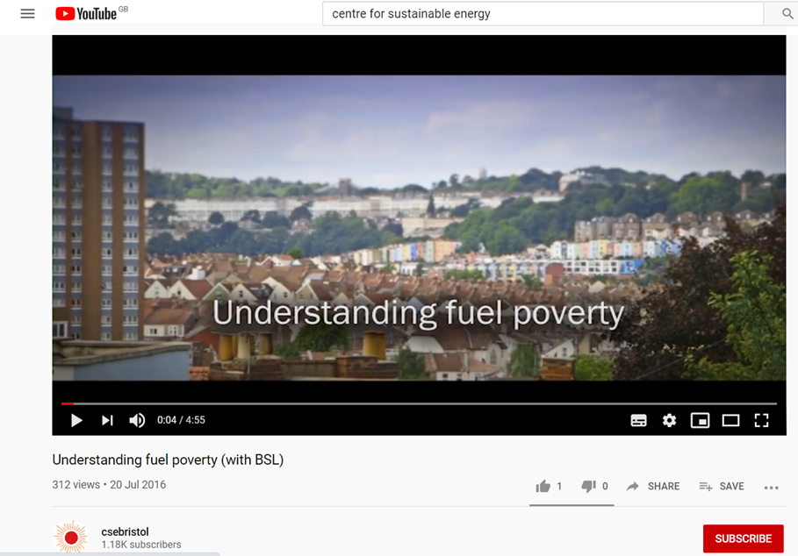
What is fuel poverty?
Film by The Centre for Sustainable Energy Bristol on Understanding Fuel Poverty
https://www.youtube.com/watch?v=Zki6ViYCSw0

Slide 6
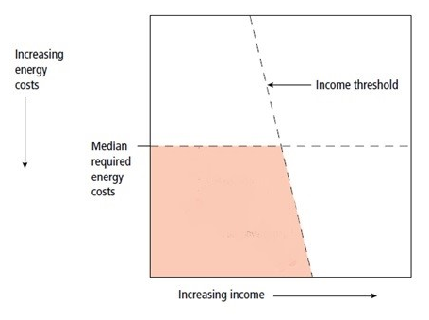
What is fuel poverty?
Fuel poverty

Slide 7

Causes of fuel poverty?
Cost of fuel, especially the fuel used to heat the home e.g. gas, LPG gas, oil, coal
Household income
Energy efficiency of the home – the energy rating of your home makes a big difference

Slide 8
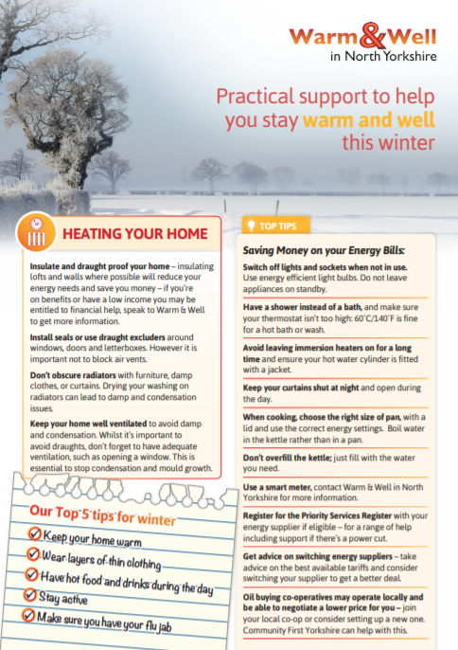
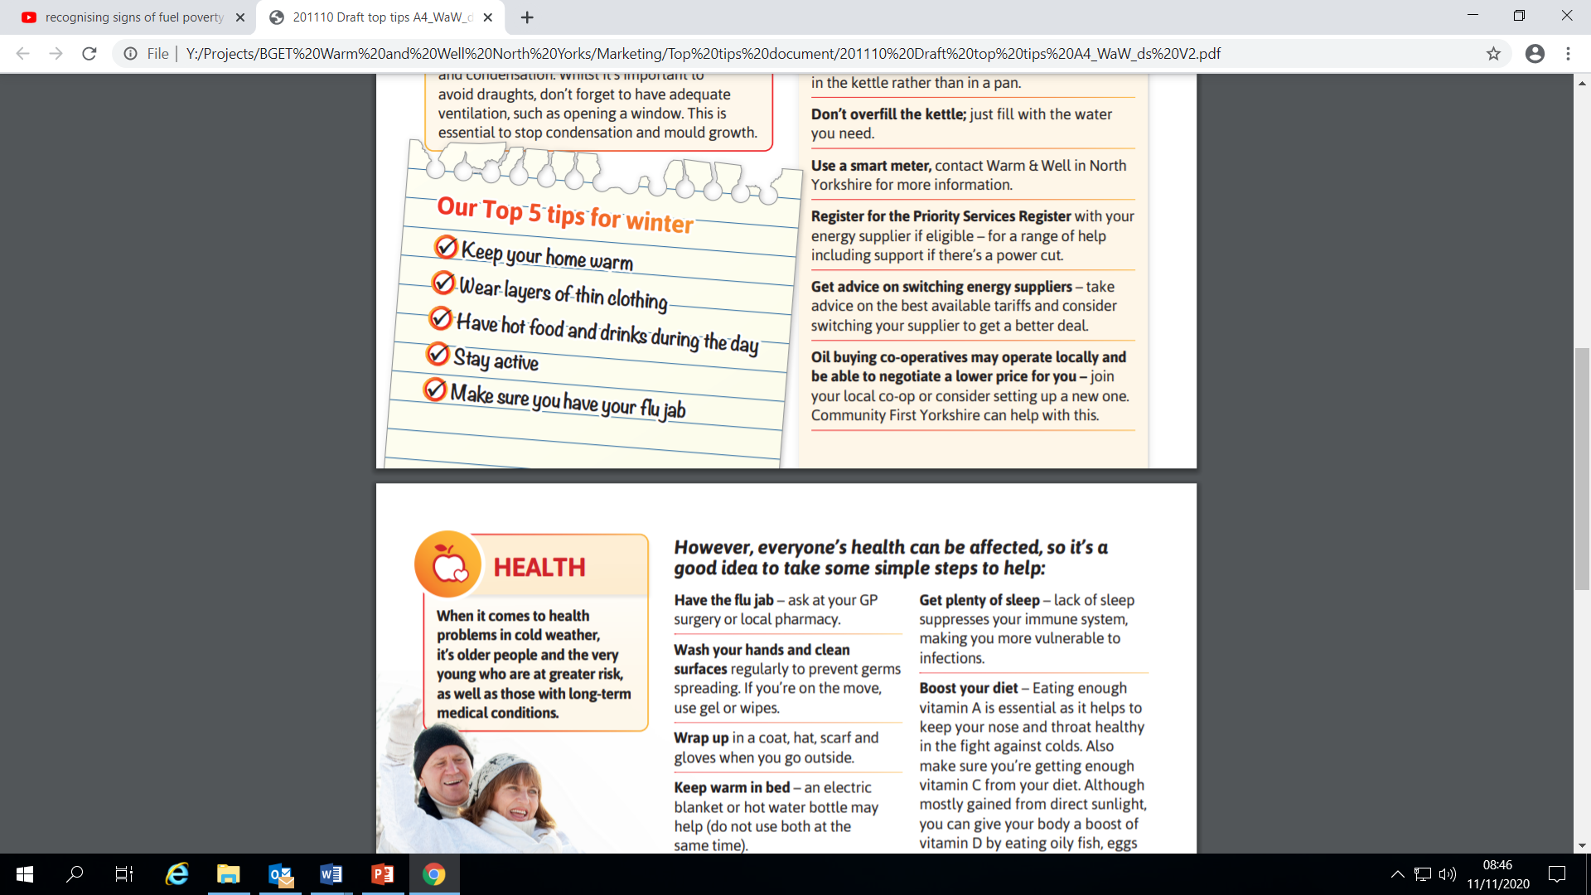
How to keep Warm & Well?

Slide 9

Tips to keep your home warmer
Insulate your home
Draught proof your home
Don’t cover or block radiators with furniture, damp clothes, or curtains.
Keep your home well ventilated to avoid damp and condensation.
Use thermal curtains, especially in single glazed homes

Slide 10
How to save money on your energy bills
Compare and switch energy supplier or tariff. Use an Ofgem approved comparison website.
https://www.uswitch.com/
https://energycompare.citizensadvice.org.uk/
Warm Homes Discount
Priority Services Register
Citizens Advice website has information on both WHD And PSR https://www.citizensadvice.org.uk/consumer/energy/energy-supply/get-help-paying-your-bills/grants-and-benefits-to-help-you-pay-your-energy-bills/

Slide 11
Tips to help support others in your community
Film by Centre for Sustainable Energy Bristol on Spotting the signs of fuel poverty
https://www.youtube.com/watch?v=yWQtiK4_3f4
Goes into a bit more detail than you need but does make some useful points
Identifying people who may be living in fuel poverty or at risk
Much easier when you can visit someone in their home, trickier to spot in the Covid-19 world
Signs like money worries or a sudden change in income, needing to top up PAYG meter more than usual, increase in illness symptoms like arthritis or respiratory illness.
A reliance on open and honest conversations between neighbours and communities

Slide 12
Tips to help support others in your community
Support someone to switch supplier or tariff.
Help them to apply for Warm Home Discount (WHD)
Encourage them to be added to the Priority Services Register
Set up a group of people in your village or area that willing to help others with going online to switch supplier or tariff or access the WHD
Support the local foodbank or village hall to set up a service whereby people in need can access winter packs – could include things like soups, supplies to make hot drinks, hot water bottles and blankets.
Encourage your parish and local area to publish information on energy saving e.g. newsletter, social media, village hall, local shop/café/pub

Slide 13
Tips to help support others in your community
Signpost to other services
Warm & Well in North Yorkshire helpline
Citizens Advice for support with debts, benefits, employment, etc. Find details of your local office on their website https://www.citizensadvice.org.uk/
North Yorkshire County Council Living Well Service. Fact sheet that applies to the whole county although on Scarborough and Ryedale website.
https://www.scarboroughryedaleccg.nhs.uk/wp-content/uploads/2019/05/467.-nycc-living-well-fact-sheet.pdf
Also may be other local services such as social groups, Carers Resource, etc

Slide 14
What help is available through WWNY:
Telephone advice and referral to further services through the single point of contact helpline
Home visits – support with switching, billing issues, energy debts, also a full energy efficiency survey to identify ways that a person can improve the warmth of their homes.
Energy Efficiency Measures and small home repairs – funded a wide range of measures including a boiler service and repairs, draught proofing, energy efficient light bulbs, etc. We also have a pot of funding to help people meet the client contribution of larger measures e.g. ECO funded boiler replacement or insulation
1-2-1 Debt advice
Hardship funds – top up vouchers, emergency heating sources, funding for minimum delivery of oil

Slide 15
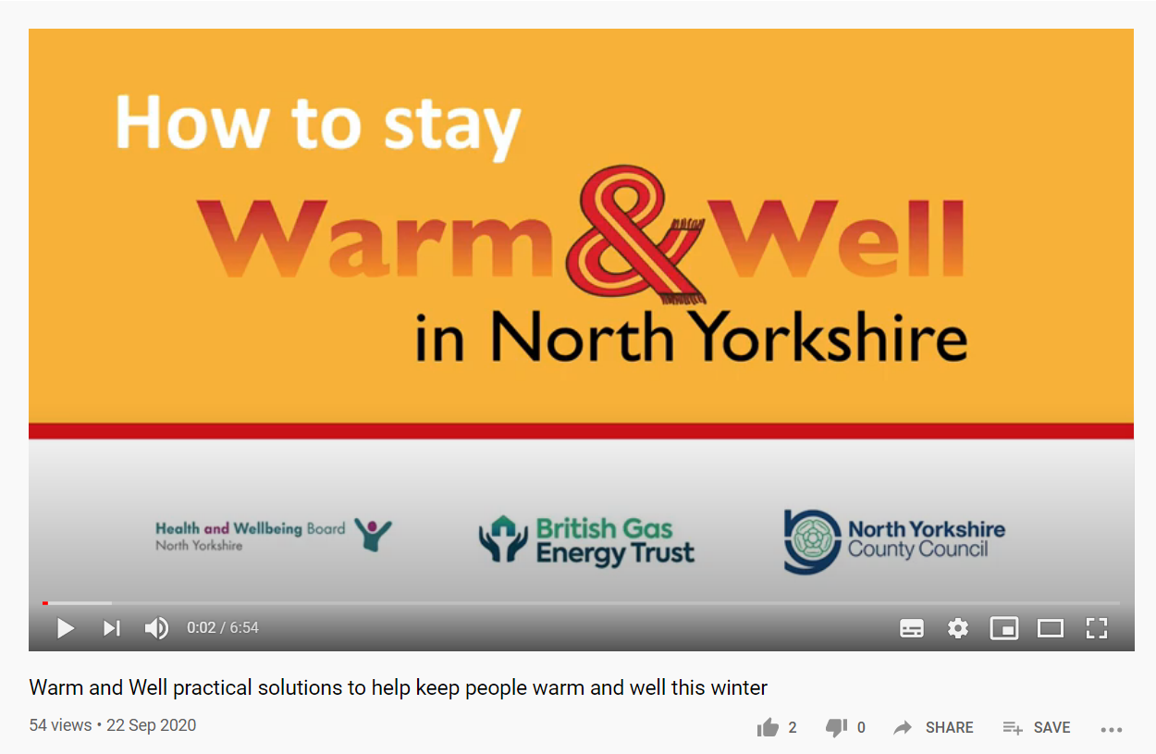
How to refer into WWNY:
Call 01609 767555
Email wnw@northyorkslca.org.uk
online referral on warmandwell.org.uk
Film by Community First Yorkshire on Warm and Well practical solutions to help keep people warm and well this winter
https://www.youtube.com/watch?v=gTJ0w32GbBg&t=1s

Slide 16

Any questions please get in touch with me Laura.thomas@communityfirstyorkshire.org.uk or call the office on 01904 704177.
Website: www.warmandwell.org.uk
Telephone: 01609 767 555
Email: wnw@northyorkslca.org.uk
Twitter: @WarmWellNY
Facebook: @warmandwell2018

